Slide 1
Adoption of AI GPT in Higher Education
Team members:
ELGHAZOUI Mohamed 22020718
ELHAJOUJI Salmane 22016152
EL YATIMI Othmane 22016963
RYANY Aymane 22017181
BADRY ZAKARIA 22014301
Supervised by
Dr MOUMEN Aniss

Slide 2
Problematic

Slide 3
Problematic
IT students in higher education must consider both the advantages and disadvantages of the Generative Pre-trained Transformer (GPT) artificial intelligence (AI) technology's rapid development. While incorporating GPT AI into the curriculum offers students practical experience and real-world project opportunities, there are drawbacks as well. Students may find it challenging to keep up with the rapid technological improvements and the sheer number of information that is available to them. The use of GPT AI in education also raises ethical questions about algorithmic bias, data security, and privacy. It is critical to look into how GPT AI technology affects IT students, identify difficulties and potential drawbacks, and give students the information and awareness they need to make wise decisions in order to achieve a thorough and balanced education.

Slide 4
Research question:
What is the influence of (GPT) AI technology on IT students in higher education?

Slide 5
Research hypotheses:
• Students who perceive fewer problems with using technologyin higher education are more likely to adopt technology.
• Students who recognize the usefulness of technology inhigher education are more likely to adopt technology.
• The adoption of IA GPT in higher education practice influences the educational level of students.
Target Population:
Higher education engineering students

Slide 6
Sampling plan:
sampling method
stratified sampling (equal or representative)
minimum sample size
68 (34F . 34M)
Confidence 95%
Margin of error 5%

Slide 7
Data dictionary:
DATA | QUALITATIVE/QUANTITATIVE | TYPE | DESCRIPTION
AGE | QUANTITATIVE | NUMERIC | CONTROL
GENDER | QUALITATIVE | ALPHABETIC | CONTROL
FILLIERE | QUALITATIVE | ALPHABETIC | CONTROL
ITEM ADOPTION | Qualitative | ALPHABETIC | EXPLICATING
ITEM UTILITY | Qualitative | ALPHABETIC | CONTROL
ITEM UTILISATION | Qualitative | ALPHABETIC
ITEM INTENTION OF USE | Qualitative | ALPHABETIC | CONTROL
ITEM FACTOR | Qualitative | ALPHABETIC | TO EXPLAIN

Slide 8
Sample :
1st year, 2nd year and 3rd year engineering student at ENSA
Sample type :
Known target population.
Probabilistic and simple random.
Sample size
68

Slide 9
TAM model
The Technology Acceptance Model (TAM) is a theoretical framework that provides a structure for understanding and predicting the intentions of users adopting and using technology. Since it was first introduced by Fred Davis in 1986, it has become one of the most widely used models for studying technology acceptance and usage behavior. The original TAM model has been widely used and has seen several extensions and adaptations over the years. For example, the TAM 2 incorporated additional variables such as social influences and compatibility with individual values. The TAM 3 then incorporated contextual and cultural variables

Slide 10
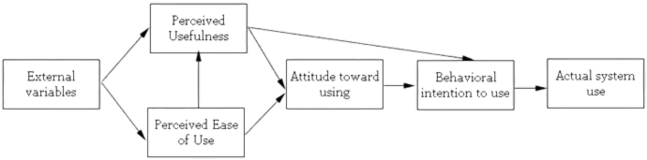
Modèle TAM
TAM posits that two main factors, perceived usefulness and perceived ease of use, play an important role in users' decision to adopt technology. Perceived usefulness refers to the extent to which an individual believes that using technology will improve their work performance and overall life. Perceived ease of use refers to the degree to which an individual believes the technology is easy to use. TAM suggests that these two factors can lead to an overall positive attitude towards technology.

Slide 11
Interviews :
We took 3 interviews with 4 colleagues :
- ELKHCHINE Mohamed
-ELHILALI Abdelhamid
-RACHOUK Wiam
-MESKINE Jalal

Slide 12
Interview guide
L'influence de la technologie d'IA GPT sur les étudiants en informatique dans l'enseignement supérieur: 1-Présentez-vous ? 2-Que pensez-vous de l'adoption de la technologie AI GPT ? 3-Avez-vous l'intention d'utiliser la technologie AI GPT ? 4-Comment envisagez-vous votre adoption personnelle de la technologie AI GPT ? 5-Que pensez-vous de l'utilisation de la technologie AI GPT ? 6-Que pensez-vous de l'utilité de la technologie AI GPT ? 7-Y a-t-il d'autres facteurs qui influencent l'intention d'utiliser l'AI GPT, en dehors de l'utilisation et de l'utilité ?

Slide 13

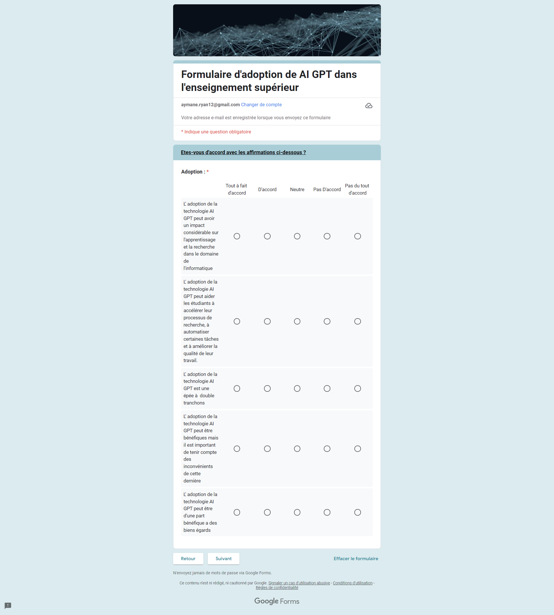
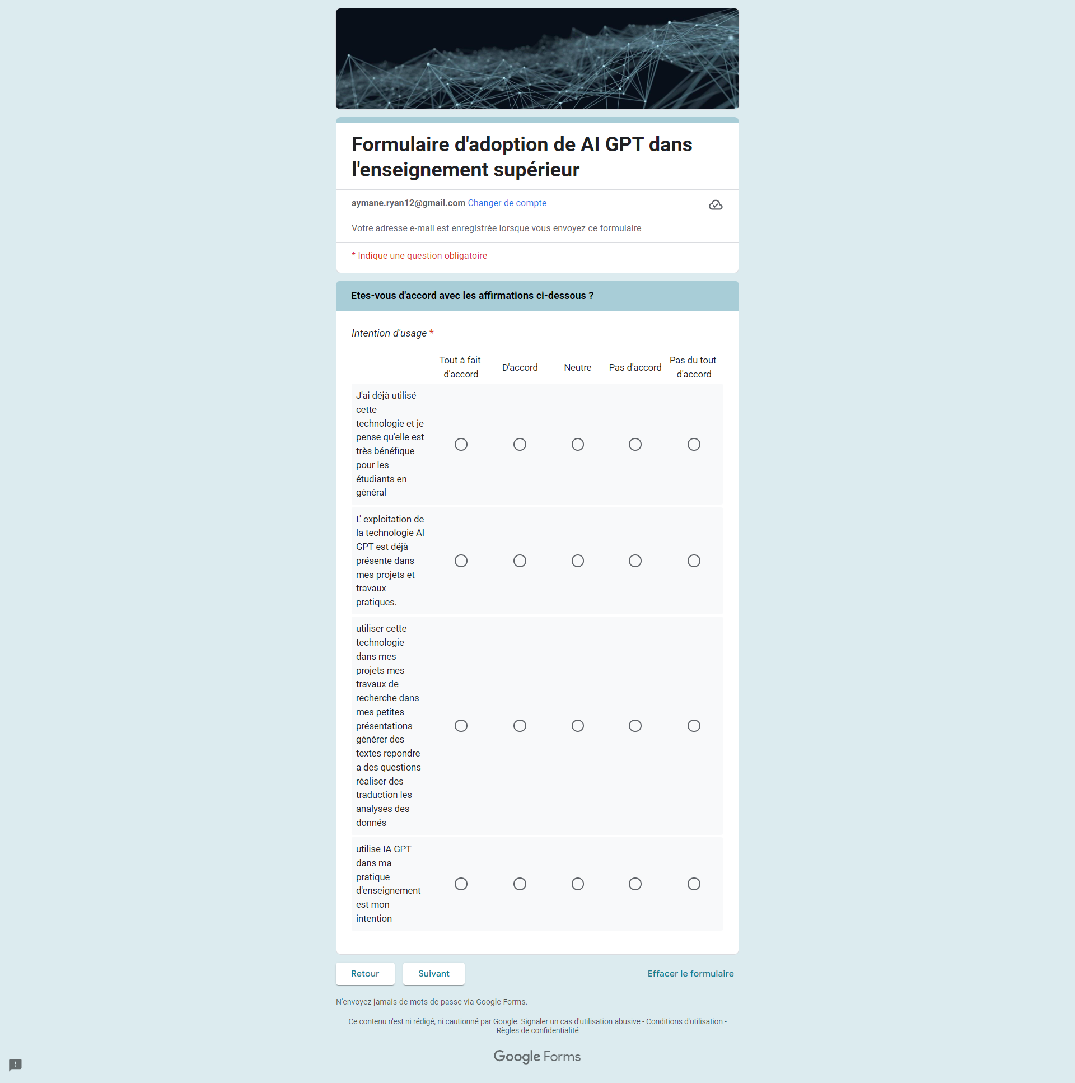
Form

Slide 14
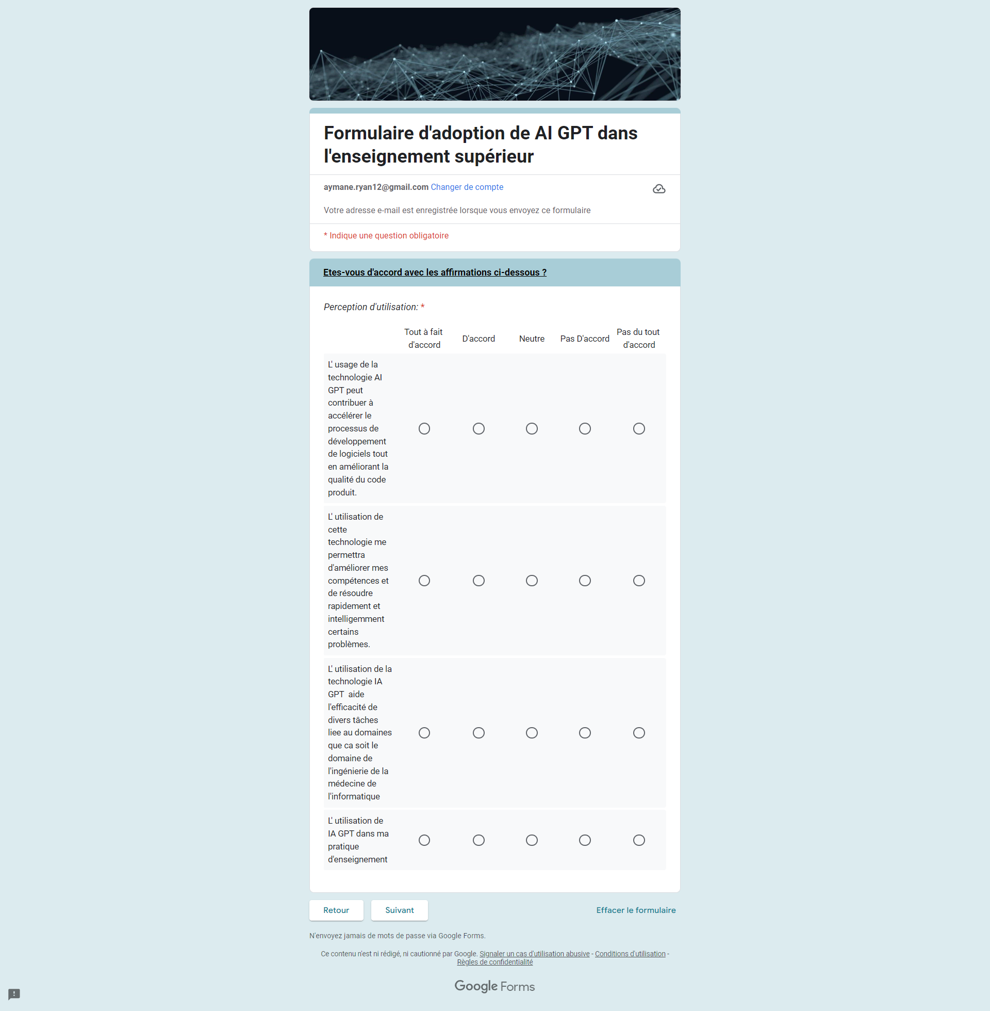

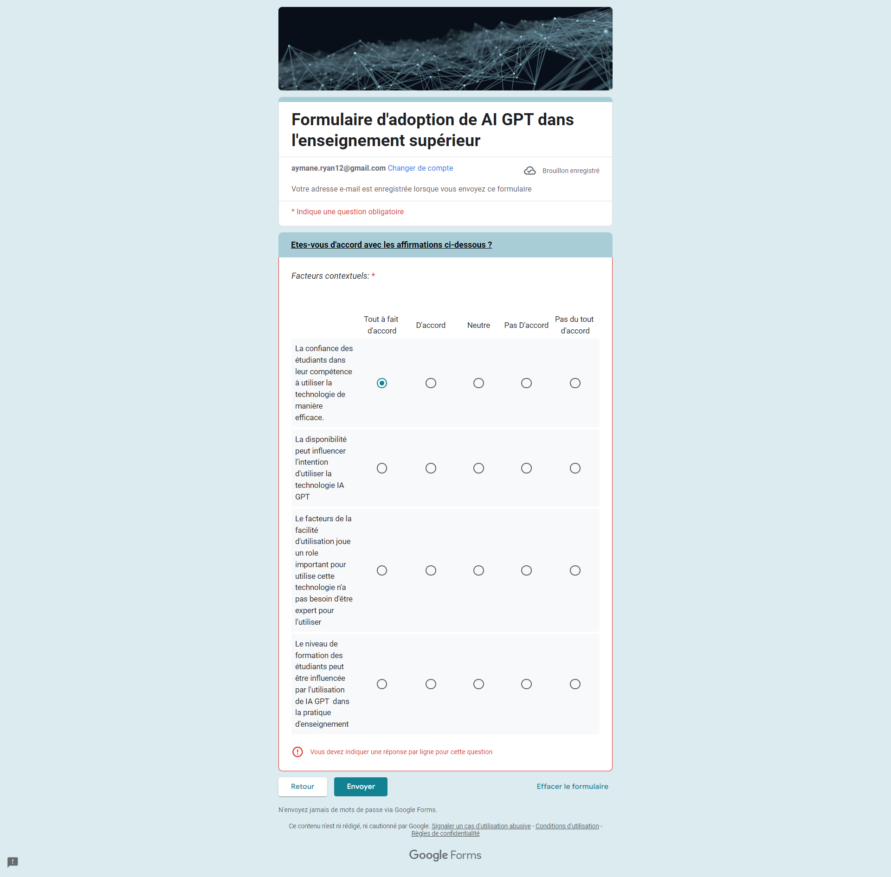
Form

Slide 15
DATA Importation
library(readxl) M <- read_excel("C:/Users/hp/Desktop/form.xlsx") View(M) colnames(M)<-c("email","genre","age","filiere","itemA1","itemA2", "itemA3","itemA4","itemA5","itemI1","itemI2","itemI3","itemI4","itemUT1","itemUT2","itemUT3","itemUT4","itemU1","itemU2","itemU3","itemU4","itemf1","itemf2","itemf3","itemf4")

Slide 16
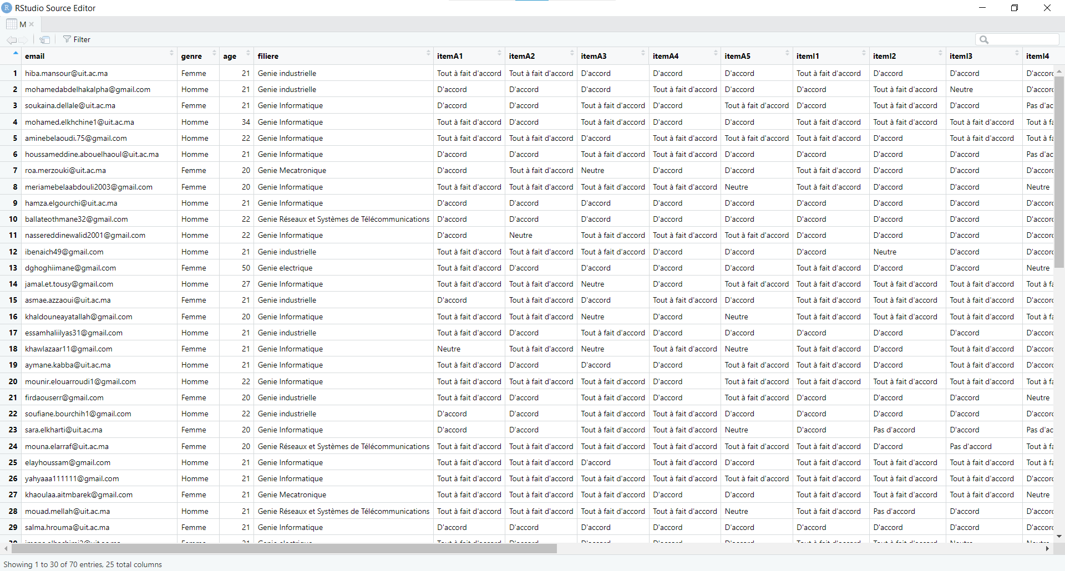
Importing Data

Slide 17
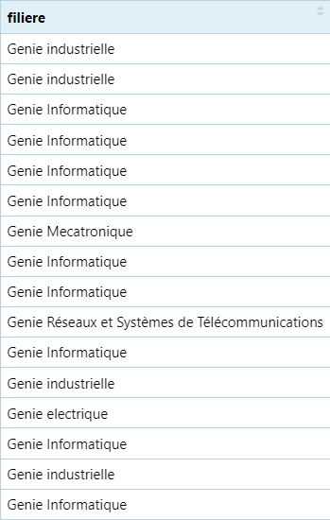
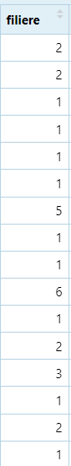
DATA Conversion
if(is.character(M$filiere)) { for(i in 1:length(M$filiere)){ if(M$filiere[i]=="Genie Informatique"){ M$filiere[i]="1"} else if(M$filiere[i]=="Genie industrielle"){ M$filiere[i]="2"} else if(M$filiere[i]=="Genie electrique"){ M$filiere[i]="3"} else if(M$filiere[i]=="Genie civil"){ M$filiere[i]="4"} else if(M$filiere[i]=="Genie Mecatronique"){ M$filiere[i]="5"} else{ M$filiere[i]="6"} M$filiere<-as.integer(M$filiere) }
Filiere

Slide 18
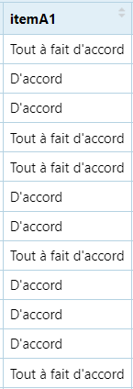
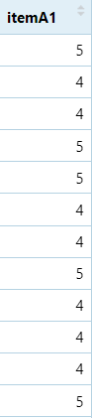
DATA Conversion
if(is.character(M$itemA1)) { for(i in 1:length(M$itemA1)){ if(M$itemA1[i]=="Pas du tout d'accord"){ M$itemA1[i]="1"} if(M$itemA1[i]=="Pas D'accord"){ M$itemA1[i]="2"} if(M$itemA1[i]=="Neutre"){ M$itemA1[i]="3"} if(M$itemA1[i]=="D'accord"){ M$itemA1[i]="4"} if(M$itemA1[i]=="Tout à fait d'accord"){ M$itemA1[i]="5"} } M$itemA1<-as.integer(M$itemA1) }
Items

Slide 19
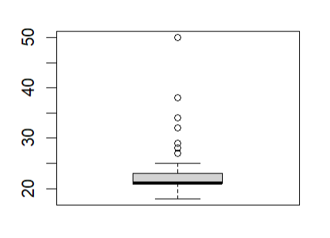
DATA Cleaning
To do so we have to know the outliers first, using the command: boxplot(M$age)
boxplot(M$age)

Slide 20
DATA Cleaning
Age
j <- 0
for (i in 1:length(M$age)) {
if (M$age[i] %in% boxplot.stats(M$age)$out) {
j <- j + 1
}
}
j
pna <- j / length(M$age)
pna
PNA= 0.1571429
pna >5% (15.71%) So we estimate by the mean value

Slide 21
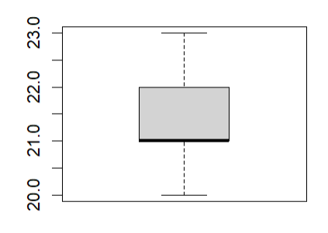
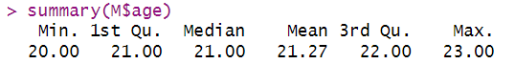
DATA Cleaning
for (i in (1:length(M$age))) { if (M$age[i] %in% boxplot.stats(M$age)$out) M$age[i]=as.integer(mean(M$age,na.rm = TRUE)) }
Age
boxplot(M$age)

Slide 22
boxplot(M$item) boxplot.stats(M$item) boxplot.stats(M$item)$out for (i in 1:length(M$item)) { if (M$item[i] %in% boxplot.stats(M$item)$out){M$item[i] <- NA} }
DATA Cleaning
ITEMS
#Replacing outlier values with NA
j <- 0
for (i in 1:length(M$item)) {
if (is.na(M$item[i])) {
j <- j + 1
}
}
j
pna <- j / length(M$item)
pna
#Calculating the PNA
If PNA>5% we delete the outliers

Slide 23
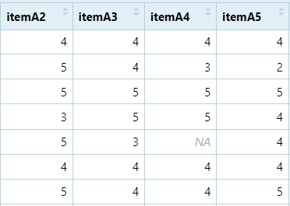

Slide 24
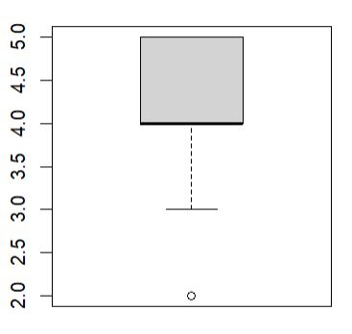
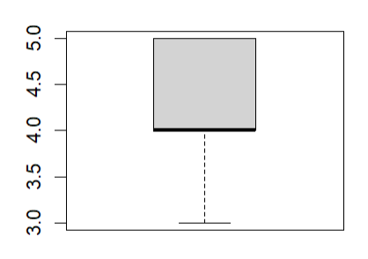
for (i in 1:length(M$item)) { if (is.na(M$item [i])) { M$item[i]=0 } }
DATA Cleaning
ITEMS

Slide 25
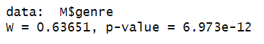
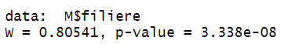
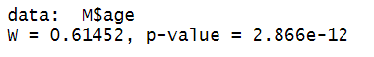
Normality Test
We apply this test only for quantitative value. To do so we use Shapiro-Wilk test. P-value < 5% The variables doesn’t follow the normal law.

Slide 26
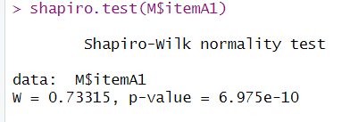
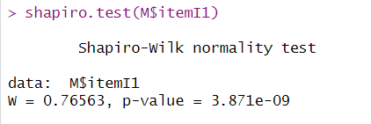
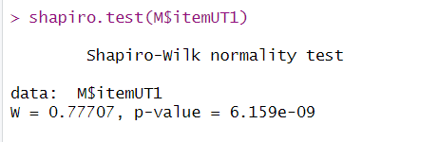
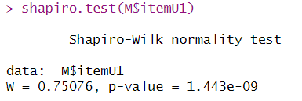
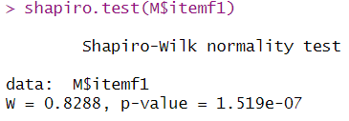
Normality Test
P-value<5% H1 accepts , There is a significant difference between the normal distribution and the distribution
So we check the quasi-normality

Slide 27
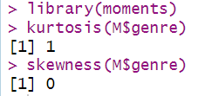
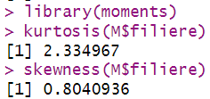
Quasi Normality
kurtosis and skewness between [-3,3] , that means we have quasi-normality
Genre and filliere follow the quasi-normality law

Slide 28
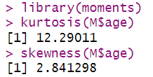
Quasi Normality
kurtosis and skewness are not between [-3,3] , that means we have quasi-normality
Age doesn’t follow the quasi-normality law

Slide 29
Univariate Analysis
Univariate analysis is the simplest form of analyzing data. “Uni” means “one”, so in other words my data has only one variable. It doesn’t deal with causes or relationships (unlike regression) and it’s major purpose is to describe, It takes data, summarizes that data and finds patterns in the data. To visualize our data we will use the methods plot(M$variable) for the qualitative

Slide 30
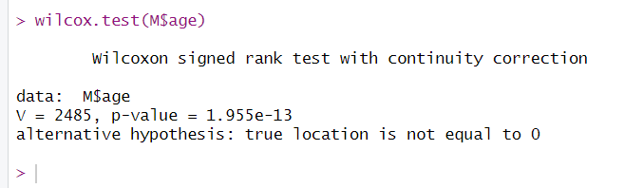
Univariate descriptive statistics Age
Age is quasi-normal so we will do the test (non-parametric)
Non-parametric test
P-value (<5%) H0 rejected, there is a significant difference from the mean

Slide 31
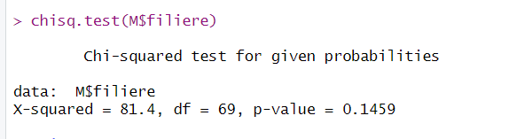
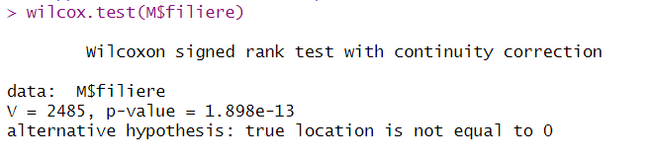
Univariate descriptive statistics filiere
Parametric test
Non-parametric test
P-value (>5%) H0 accepted , there is no significant difference from the mean
P-value(<5%) H0 rejected, there is a significant difference from the mean

Slide 32
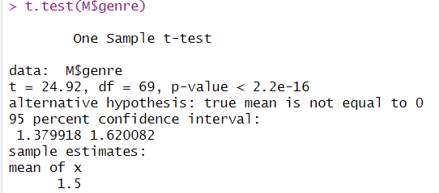
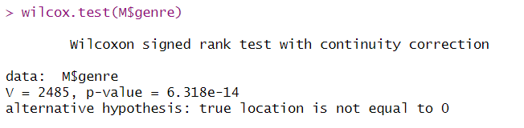
Univariate descriptive statistics Genre
Parametric test
Non-parametric test
P-value (<5%) H0 rejected, there is a significant difference from the mean
P-value (<5%) H0 rejected, there is a significant difference from the mean
If both sheikhs agree ,we follow the parametric

Slide 33
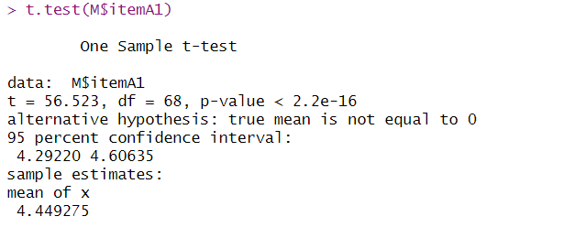
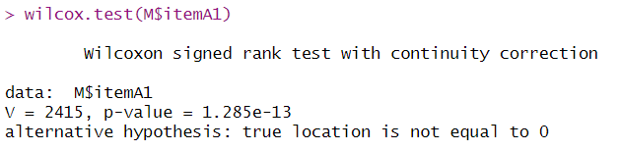
Univariate descriptive statistics itemA1
Parametric test
Non-parametric test
P-value (<5%) H0 rejected, there is a significant difference from the mean
P-value (<5%) H0 rejected, there is a significant difference from the mean
If both sheikhs agree ,we follow the parametric

Slide 34
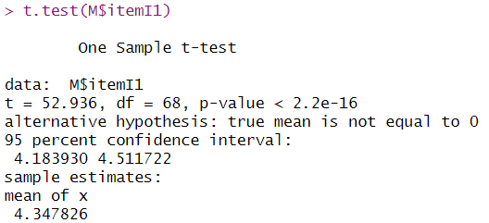
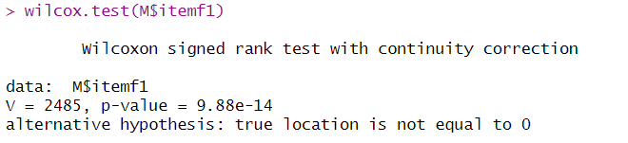
Univariate descriptive statistics itemI2
Parametric test
Non-parametric test
P-value (<5%) H0 rejected, there is a significant difference from the mean
P-value (<5%) H0 rejected, there is a significant difference from the mean
If both sheikhs agree ,we follow the parametric

Slide 35
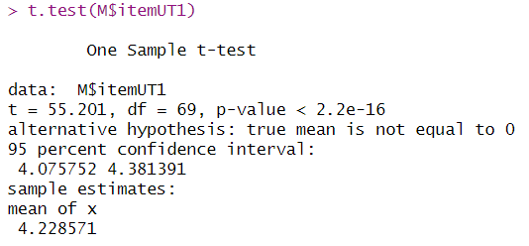
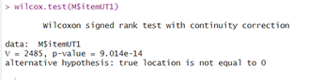
Univariate descriptive statistics itemUT1
Parametric test
Non-parametric test
P-value (<5%) H0 rejected, there is a significant difference from the mean
P-value (<5%) H0 rejected, there is a significant difference from the mean
If both sheikhs agree ,we follow the parametric

Slide 36
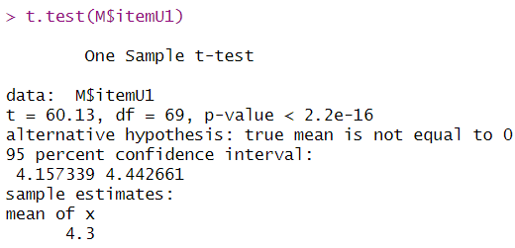
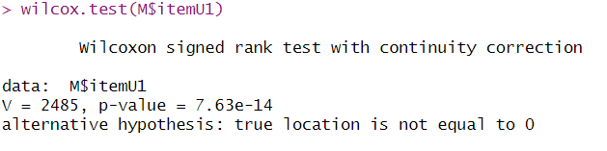
Univariate descriptive statistics itemU1
Parametric test
Non-parametric test
P-value (<5%) H0 rejected, there is a significant difference from the mean
P-value (<5%) H0 rejected, there is a significant difference from the mean
If both sheikhs agree ,we follow the parametric

Slide 37
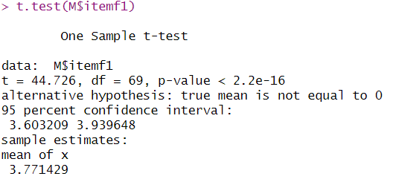
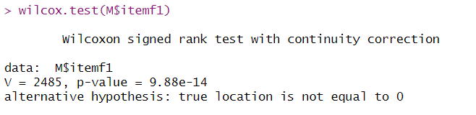
Univariate descriptive statistics itemf1
Parametric test
Non-parametric test
P-value (<5%) H0 rejected, there is a significant difference from the mean
P-value (<5%) H0 rejected, there is a significant difference from the mean
If both sheikhs agree ,we follow the parametric

Slide 38
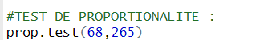
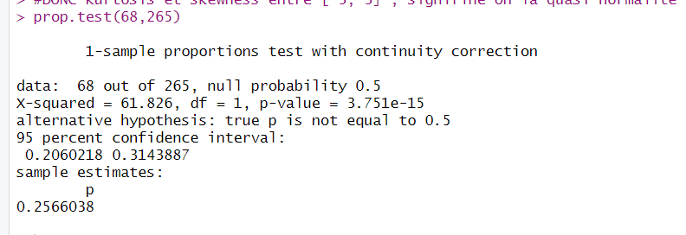
Proportionality Test
p_value=3.751e-15<0.05 ,
So H0 rejects , H1 to retain:
the two proportionalities are significantly different,
that then at the sample level the proportionalities are 50%/50%

Slide 39
Summary(data)
summary() function is a generic function used to produce result summaries of the results of various model fitting functions. The function invokes particular methods which depend on the class of the first argument.

Slide 40
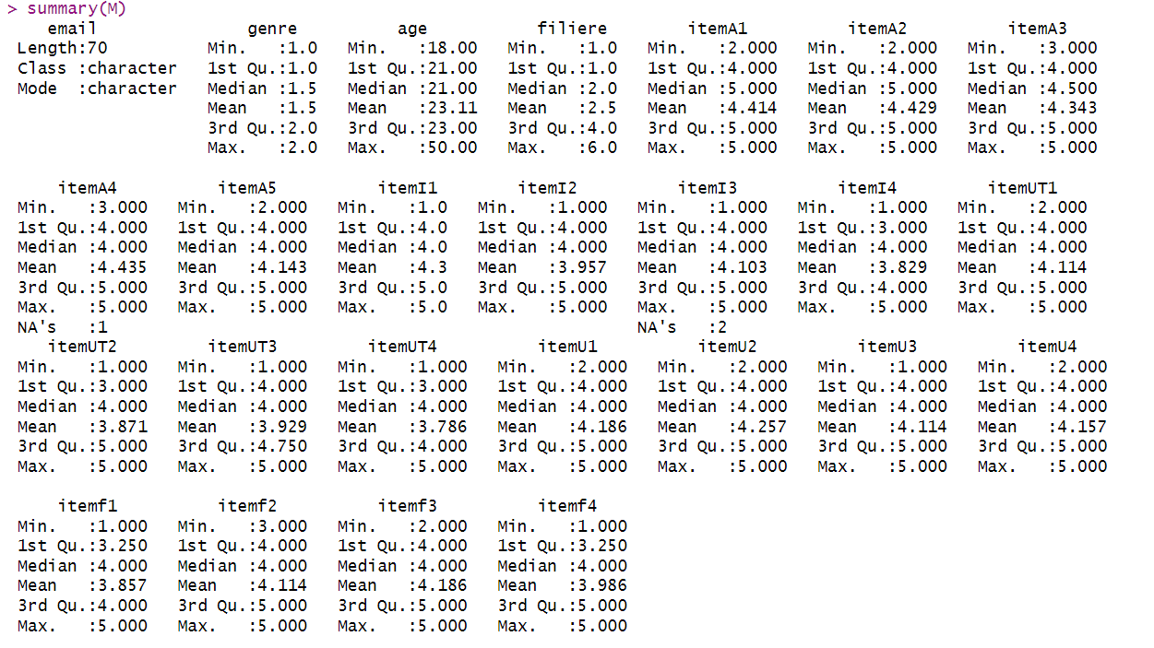
Summary(M)

Slide 41
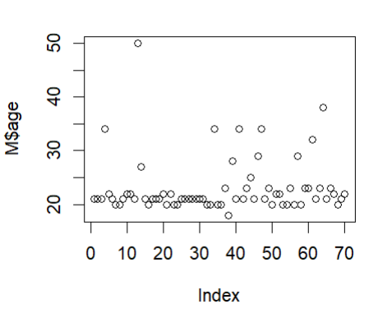

Slide 42
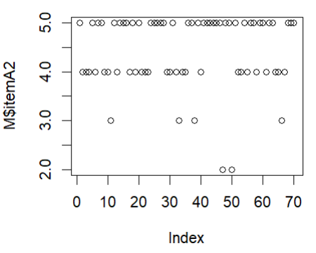
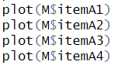
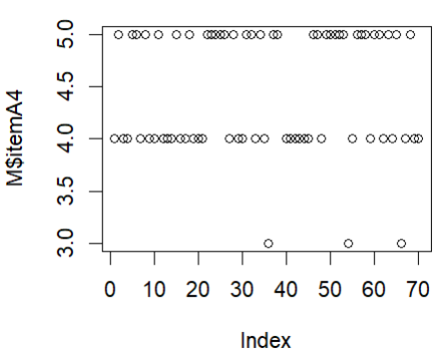

Slide 43
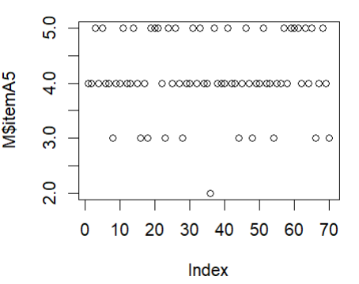





Slide 44






Slide 45






Slide 46


Slide 47
Reliability analysis

Slide 48
Sognificativite

Slide 49


Reliability analysis
We have alpha = 0.5512 , we remove item we see that the value of alpha decreases
We alpha =0.4986 , we remove item we see that the value of alpha decreases

Slide 50


Reliability analysis
with Alpha reliability = 0.6976
removing itemI4
We do the same for itemUT
the value of alpha goes to 0.7275

Slide 51
Bivariate Analysis
Bivariate Analysis is one of the simplest forms of statistical analysis. It involves the analysis of two variables (often denoted as X, Y), for the purpose of determining the empirical relationship between them. Bivariate analysis can be helpful in testing simple hypotheses of association.

Slide 52




Bivariate Analysis Genre et filiere (quali quali)
P-value = 0.159 >5%
Genre does not impact filiere

Slide 53


Bivariate Hypothesis testing

Slide 54




Bivariate Hypothesis testing filiere et age (quali quanti)

Slide 55


Bivariate Hypothesis testing

Slide 56




Bivariate descriptive statistics quali quanti

Slide 57


Bivariate Hypothesis testing

Slide 58
Bivariate descriptive statistics research hypothesis test
Is there a relationship between the perception of problems related to the use of technology and adoption of it by students?
H0: There is no relationship between the perception of problems related to the use of technology in higher education and the adoption of technology by students.
H1: Students who perceive fewer problems with using technology in higher education are more likely to adopt technology.
According to the univariate tests, we found that itemA and itemUT follow the normal law

Slide 59

Bivariate descriptive statistics research hypothesis test
We first perform the variance test.

Slide 60
Bivariate descriptive statistics research hypothesis test
HYPOTHESIS 2
Is there a relationship between recognition of the usefulness of technology and its adoption by students?
H0: There is no relationship between the recognition of the usefulness of technology inhigher education and student adoption of technology.
H1: Students who recognize the usefulness of technology in teachinghigher are more likely to adopt the technology.

Slide 61


Bivariate descriptive statistics research hypothesis test
We first do the variance test.
In our case we P-value = 0.4639(>0.05),
H0 accepted,
In our case we P-value = 0.007185(<0.05), H1 accepted,

Slide 62
Bivariate descriptive statistics research hypothesis test
HYPOTHESIS 3
Is there a relationship between the adoption of AI GPT in teaching practice and
the level of education of the students
H0: There is no relationship between the adoption of AI GPT in teaching practice and the level of training of students.
H1: There is a relationship between the adoption of AI GPT in teaching practice and the level of education of students..

Slide 63

Bivariate descriptive statistics research hypothesis test
According to the univariate tests, we found that itemA and itemU follow the normal law
We first do the variance test.
In our case we P-value = 0.007185(<0.05), H1 accepted,

Slide 64
Regression

Slide 65




Simple regression
p-value=0.8339 , there is a correlation
3. We already check that X and Y follow normal law
4. a!=0 and b!=0
5. error -> 0
Terms :
A
1. Quantitative X and Y
X: itemA1
Y:itemf1
2. X and Y correlate

Slide 66




Simple regression
p-value=0.2846 , there is a correlation
3. We already check that X and Y follow normal law
4. a!=0 and b!=0
5. error -> 02. X and Y correlate
Terms :
B
1.X and Y quantitative
x: itemA1
Y:itemf1
2. X and Y correlate

Slide 67




Simple regression
P-value=0.6446 , there is a correlation
3. We already check that X and Y follow normal law
4. a!=0 and b!=0
5. error -> 0
Terms :
c
1.X and Y quantitative
x: itemA3
Y:itemf3
2. X and Y correlate

Slide 68




Multiple regression
A
1.Xi et Y quantitative
xi : itemAi
Y : itemf1
2. Xi et Y correlate
there is a correlation
3. We already check that X and Y follow normal law
4. a!=0 and b!=0
5. error -> 0

Slide 69



Multiple regression
B
1.Xi et Y quantitative
xi : itemAi
Y : itemf2
2. Xi et Y correle
there is a correlation
3. We already check that X and Y follow normal law
4. a!=0 and b!=0
5. error -> 0

Slide 70




Multiple regression
there is a correlation
3. We already check that X and Y follow normal law
4. a!=0 and b!=0
5. error -> 0
6 . aji<=1
C
1.Xi et Y quantitative
xi : itemAi
Y : itemf3
2. Xi et Y correle

Slide 71




Multiple regression
D
1.Xi et Y quantitative
xi : itemAiY : itemf4
2. Xi et Y correlate
there is a correlation
3. We already check that X and Y follow normal law
4. a!=0 and b!=0
5. error -> 0
6 . aji<=1

Slide 72
Classification

Slide 73



Classification
For Adoption:

Slide 74



Classification
For factor:

Slide 75



Classification
For factor and adoption:

Slide 76
Word cloud

Slide 77

Words cloud

Slide 78
Conclusion and perspectives

